Slide 1
Interaction Styles and How They Relate to Project Situations
Usability Engineering: Process, Products, and Examples
Chapter 8

Slide 2
Reminder about Usability
Usability is an outcome of the interaction of situational variables and characteristics of the user interface.
We can design the user interface but we are GIVEN the situation.
To improve your chances of good usability, you should select an interaction style that is APPROPRIATE for the situation.
  The commercial success of some popular products may lead us to believe that there is a “one-size fits all” solution for every situation, but that is not true.

Slide 3
Structure of Presentations for Interaction Styles
For each interaction style presented in Chapter 8, the following information is presented.
  Definition and description of the interaction style
  Situations in which the interaction style is most likely to be appropriate.
  Design decisions and guidelines for this interaction style.
  Overview of different options for the interaction style.
  Examples.

Slide 4
Menu Interactions
Definition
  A menu presents options or choices explicitly.
Menus consist of a series of options which may be combined with an id (title), help text, or navigational information.

Slide 5
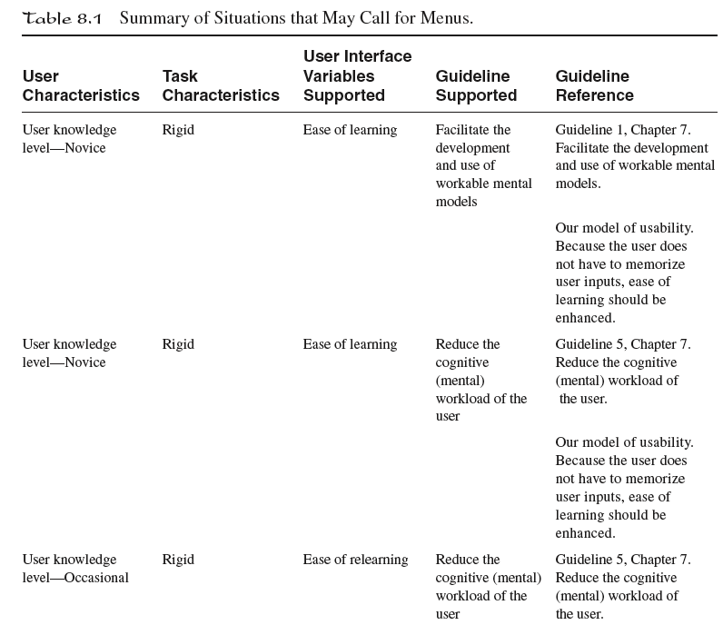
Summary of Situations Which May Call for Menus

Slide 6
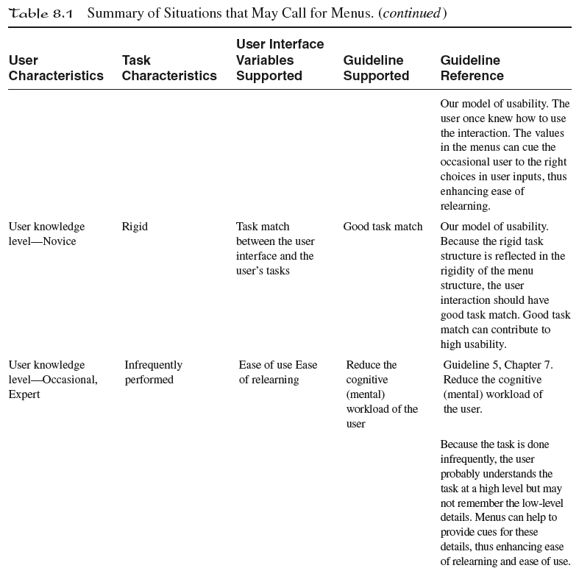
Summary of Situations Which May Call for Menus

Slide 7
Menu Advantages
They can provide tightly-structured tasks that can help the user build a conceptual model of the task.
Menus can reduce the user’s cognitive workload because users can "recognize" their choices rather than having to "recall" what their options are.
These may be more critical concerns with novice users.

Slide 8
Design Decisions for Menus
Type of menu.
Orientation of menus.
Navigational structure of menu.
Ordering of items within menu.
Layout issues for menu.
Physical access to menu.

Slide 9
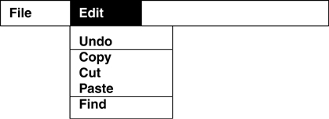
Menu Examples
Pull-Down menu

Slide 10
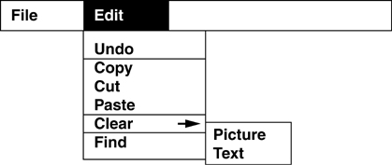
Menu Examples
Cascading menu

Slide 11
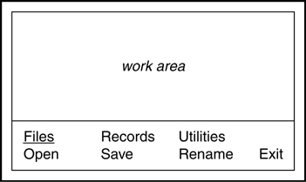
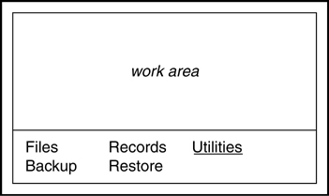
Menu Examples
Lotus-Style menus

Slide 12
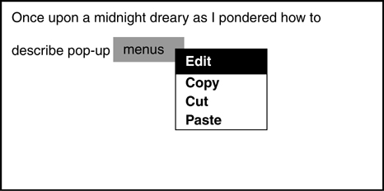
Menu Examples
Pop-Up menu

Slide 13
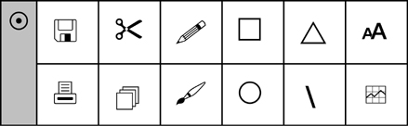
Menu Examples
Picture menu

Slide 14
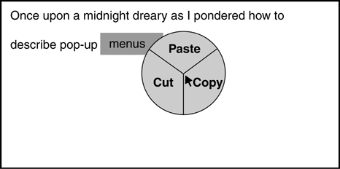
Menu Examples
Pie menu

Slide 15
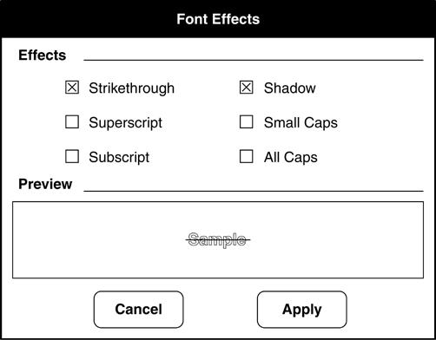
Menu Examples
Check Box menu

Slide 16
Window Interactions
Definition
  Windows divide the screen space into multiple displays.
Windows may contain borders, titles, or handles.
Window interactions my have single or multiple windows.
Windows are often used in conjunction with other interaction styles.

Slide 17
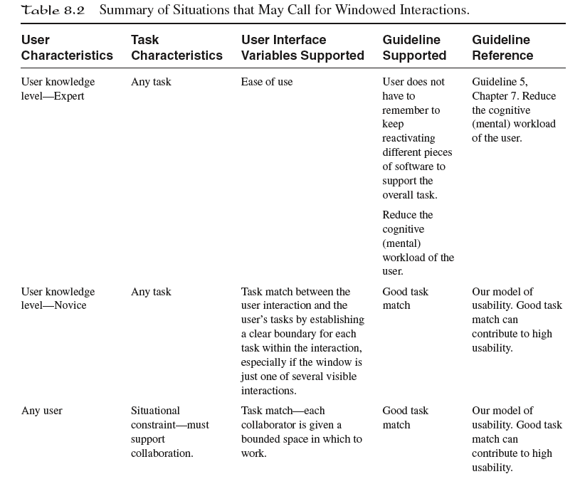
Summary of Situations Which May Call for Windows

Slide 18
Window Advantages
Multiple interactions can be separated and displayed concurrently.
Windows are a visual mechanism to show groupings.

Slide 19
Design Choices for Windows
Look and behavior of windows.
Organization of multiple windows.

Slide 20
Window Examples
Most applications on personal computers use windows to contain different components of an application.

Slide 21
Form Fill-in Interactions
Definition
  Form fill-in user interfaces are modeled after paper forms.
Users see the virtual form and fill in the empty fields.
Forms may contain blanks for data entry, titles, help text, or navigation information.

Slide 22
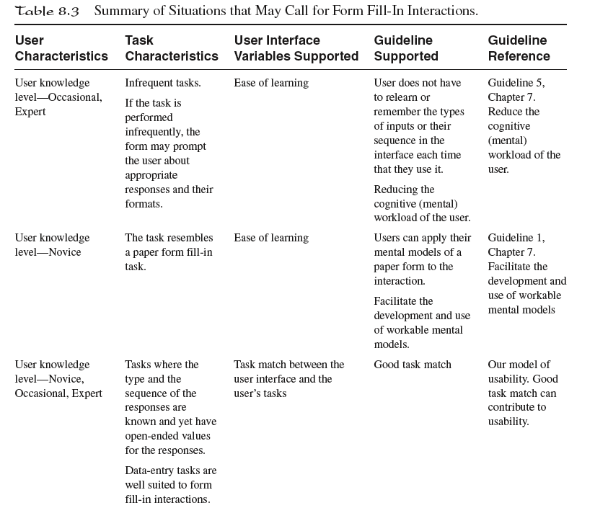
Summary of Situations Which May Call for Forms

Slide 23
Form Fill-in Advantages
Forms use recognition to reduce the user’s cognitive workload.
Recall is required by the user to determine what constitutes legal data for fields.

Slide 24
Design Choices for Forms
Visual design of forms.
Navigation across multiple forms.
Error prevention.

Slide 25
Form Examples
Request for Psychic Reading
Name
Street Address
Method of Last Reading
City, State and Zip code
Date of Last Reading
Schedule Reading

Slide 26
Direct Manipulation Interactions
Definition
  Direct manipulation interactions use visual objects to represent data and a pointing device to manipulate them.
Characteristics
  Continuous representation of presentation.
  Physical user actions manipulate presentation.
  Impact of actions on presentation is immediate.

Slide 27
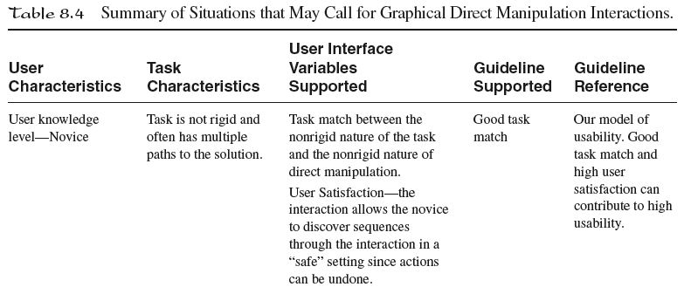
Situations Which May Call for Direct Manipulation

Slide 28
Direct Manipulation Advantages
Studies suggest that graphical computer objects are easier to remember and use than keystroke objects.

Slide 29
Design Choices for
Direct Manipulation Interactions
Choice of symbols (icons).
Defining relationships of inputs to actions.

Slide 30
Direct Manipulation Examples
The operating systems of personal computers today use direct manipulation.
When you point and click on icons, you are using a type of direct manipulation.

Slide 31
Command-Line Interactions
Definition
  Command line interactions are typically text based using a constrained set of symbols.
Users have to learn the command language.
  Vocabulary
  Syntax

Slide 32
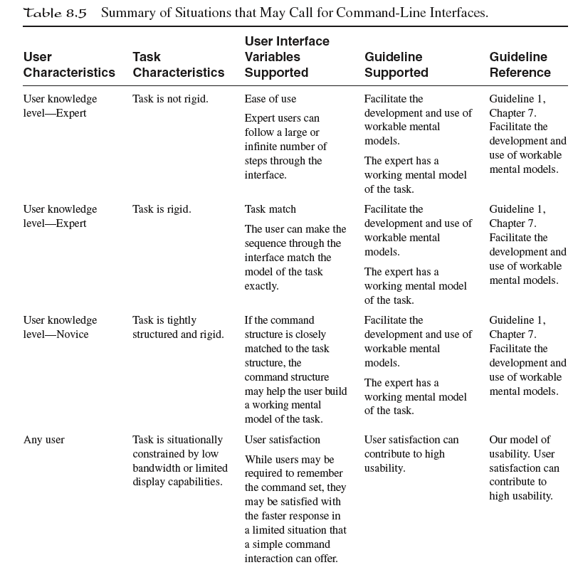
Situations Which May Call for Command-Line Interactions

Slide 33
Command-Line Advantages
A highly controlled structure may help novices form a conceptual model of the system.
Expert users may feel in control of systems with command line interfaces and be able to work at speeds that are appropriate for their skill level and sophisticated mental models.

Slide 34
Design Choices for
Command-Line Interactions
What is the symbol set (vocabulary)?
What are the rules for making commands (syntax)?
What is the mode of interaction?

Slide 35
Command-Line Examples
Older operating systems such as UNIX and DOS are examples of command-line interfaces.

Slide 36
Natural Language Interactions
Definition
  Natural language interactions use a symbol set derived from a naturally occurring set of symbols and possibly naturalistic syntax.
Natural language interactions usually use a subset of a natural language like English or French.
Natural language interactions are different from speech recognition systems.

Slide 37
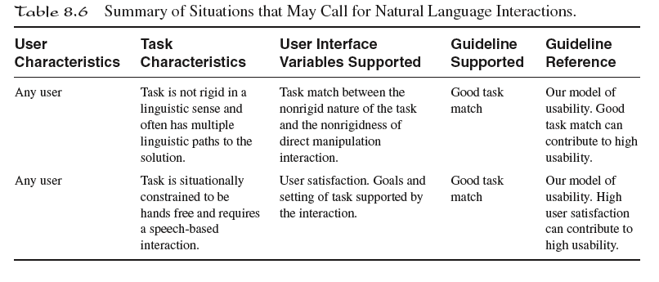
Situations Which May Call for Natural Language Interactions

Slide 38
Natural Language Advantages
Users are not required to learn a highly constrained command language, but can use a more familiar set of symbols and syntax.

Slide 39
Design Choices for
Natural Language Interactions
What is the symbol set (vocabulary)?
What are the rules for making commands (syntax)?
What is the mode of interaction?

Slide 40
Natural Language Examples
The best examples are from fictional sources:
  Chatting with a droid
  Commanding the main computer on a starship
In the real world, work is being done in developing natural language interfaces for making queries in databases.

Slide 41
Other Interaction Styles
Question-and-answer interactions.
Haptic interactions.
Multimodal and multimedia interactions.
Virtual reality interactions.
Video game interactions.
Interactions for mobile and handheld devices.

Slide 42
Conclusions
There are a number of interaction styles to choose from.
Some interaction styles are more appropriate for some users and tasks than others.

